Slide 1
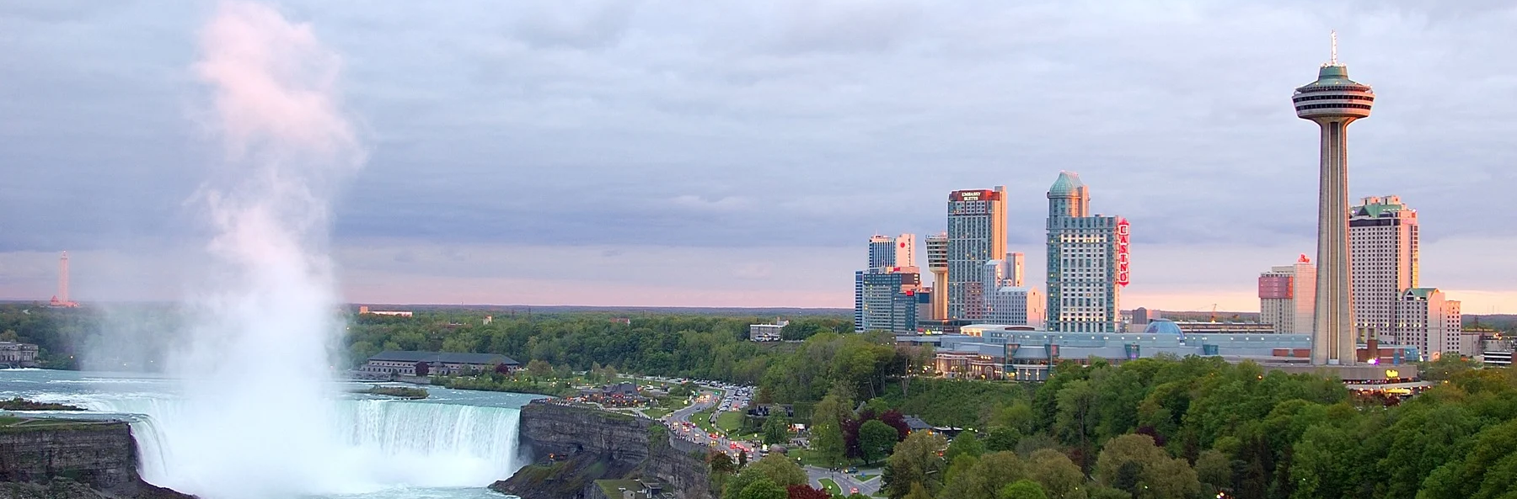
Development Charges Study, CBC Strategy Update and Related By-laws
Council Information Session
CITY OF NIAGARA FALLS
Tuesday, October 24, 2023

Slide 2
Agenda
Background
What are Development Charges?
Available Growth-Funding Tools
Recent Legislative Changes (e.g. Bill 23)
What do DCs Fund in Niagara Falls?
DC Policy Items
Project Timelines and Next Steps

Slide 3
Background
The City has retained Hemson to complete/consider:
DC Background Study
Existing City-wide DC Bylaw 2019-69 expires July 9, 2024
CBC Strategy Update
Update the current CBC Strategy and By-law (2022-119)
CBC By-law must be “reviewed” at minimum every 5-years to determine if an update to the by-law is required

Slide 4
What Are Development Charges?
Fees imposed on development to finance development-related capital costs
As a municipality grows, new infrastructure and facilities are required to maintain service levels (e.g. roads, water, etc.)
The principle is “growth pays for growth” so that the financial burden of servicing development is not borne by existing tax/rate payers

Slide 5
New Framework for “Growth-Related” Capital
Development Charges Act (DCs)
Used to fund initial round of capital infrastructure
Prescribed list of eligible services
Planning Act: Community Benefit Charges (CBCs)
Planning Act: Parkland Acquisition
No more 10% discount
Certain “soft” services removed from list (e.g. parking, cemeteries, airports)
Initial round of capital, can overlap with DCs
In-kind contributions permitted
Capped at 4% of land value
Imposed only on development with 5 or more storeys & 10 or more housing units
Only local municipalities can charge
Parkland acquisition
Standard rate of 5% for residential and 2% for non-residential
Alternative, higher rate may apply based on units/ha
Cash In Lieu permitted
All tools are appealable to OLT (with conditions)

Slide 6
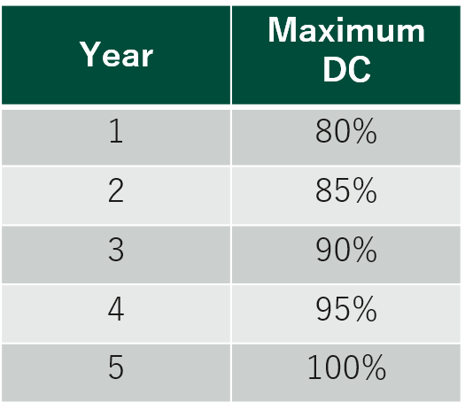
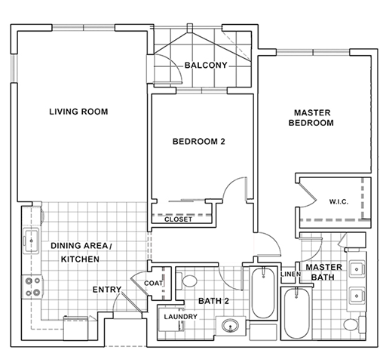
Changes to Development Charges Act
New exemptions:
Affordable/Attainable Housing (not yet inforce)
Additional units in existing rental housing
Residential intensification in existing units
Non-profit housing (defined by legislation)
Inclusionary Zoning (must be affordable)
New discounts:
Rental housing development (defined as 4+ units) based on number of bedrooms
Fully calculated rates must be phased-in over 5-year period

Slide 7
What do Residential DCs Fund in Niagara Falls?
DC Per Unit (Urban Area)
Singles & Semis $17,239
Townhouse Dwelling $10,813
Apartment Dwelling $8,194
Note: Development Charge Rates effective as of September 1, 2023.

Slide 8
What do Non-Residential DCs Fund in Niagara Falls?
DC Per Square Metre (
Urban Area (Tourist Core) $33.68
Urban Area (Non Tourist Core) $57.26
Non-Urban Area $24.44
Note: Funding percentages are different for Outside Core Tourist Area.
Note: Development Charge Rates effective as of September 1, 2023.

Slide 9
Development Charges Study Process
Growth / Development Forecast
Amount, type and location of development
Growth-Related Capital Needs
What will we need to build?
15-Year Historical Service Levels
How much can be funded from DCs?
Operating and Replacement Cost Analysis, including Asset Management Plans – for information
Capital Needs Eligible to be funded from DCs
Remainder funded from other sources
Legislated Reductions
Grants, other contributions, benefit to existing, available DC reserves, post-period benefit
Costs Eligible for DC Recovery
Residential Sector
(per unit)
Non-Residential Sector
(per m² of GFA)

Slide 10
Decision Points for Council
Consider and approve development-related capital programs
Consider area rating
Consider whether to hold another public meeting (one meeting required)
Consider implementation options within the context of legislation and other municipal objectives
Full or partial rates
Phase-ins or delayed effective dates
Exemptions
Approve 2024 DC By-law(s)

Slide 11
DC Policy Items
Review definitions in DC By-law
Review of current non-statutory exemptions:
Gas station canopies
Industrial land uses
Cemeteries, mausoleums and columbariums
Single room occupancy units that are accommodated within existing buildings and/or structures including existing motels and/or hotels
Charitable institutions
Parking structures
Agricultural uses
Municipal housing projects
Affordable housing projects (receive funding from Niagara Regional Housing)
Designated exemption areas
Rules with respect to redevelopment
Local Service Guidelines
What is a direct developer responsibility?

Slide 12
Key Steps in Passing a DC By-law
Task | Description
Release DC Background Study to the Public | 60-days prior to by-law passage (including on website)
Advertise for Public Meeting | 20-days notice
Release Proposed DC By-law | 2 weeks before the Public Meeting (or sooner)
Hold Statutory Public Meeting | Received submissions from the public and Council Amend proposed charges and by-law if warranted Determine if additional Public Meeting is required
DC By-law Passage | Any changes brought forward for adoption
Notice of By-Law Passage | 20-days after DC by-law passage
Appeal Period | 40-days following DC by-law passage
DC Pamphlet | 60-days after passage of DC by-law

Slide 13
Proposed DC Study Timeline – Key Dates
Item | Date
Prepare Draft Development Forecast | July 2023
Complete Historical Service Levels and Interview Staff | July/August 2023
Prepare DC Capital Program | Draft Fall 2023 / Finalize Early 2024
Council Info Session | September/October 2023 (Date TBD)
Preliminary DC Rate Calculation | Late November 2023
Prepare Draft DC Background Study | February/March 2024
Finalize DC Rates with Engineering Inputs | Early March 2024
Release DC Background Study to Public | Late March 2024
Notice of Public Meeting | Late March 2024
Statutory Public Meeting | Mid April 2024
By-law Passage | Late May/Early June 2024
Notice of By-law Passage | Late May/Early June 2024
Appeal Period | July 2024

Slide 14
Questions?

Slide 15
Contacts
Craig Binning – Project Director
cbinning@hemson.com
Jackie Hall – Project Manager
jhall@hemson.com
Danielle Tivoli – Day-to-Day Consultant
dtivoli@hemson.com

